Slide 1




Understanding Proficiency Testing
Donnell Charles
Sr. Manager Proficiency Testing Programs
Patricia Atkins
Senior Applications Scientist
Lauren Stainback
Global Product Manager

Slide 2

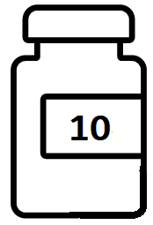


Sample Types
Samples
Unknown
Standards
CRMs
PT, QC
QMS
Unknown
Known
Known

Slide 3
Quality Management Systems
Quality objectives & manual
Organizational Structure & responsibilities
Data Management
Processes
Improvements and Corrective Actions
Document Control
Quality Assurance & Control
QMS
QC, CRM, PT
Proficiency Tests
Standards, CRMs

Slide 4


QMS & Analyses
Method
Verification &
Validation
Data Processing
YOUR TITLE 01
Documents
QMS
Organization
ISO, GMP, GLP
Data
YOUR TITLE 05
Performance &
Functioning of
Methods, Systems
& Analysts

Slide 5

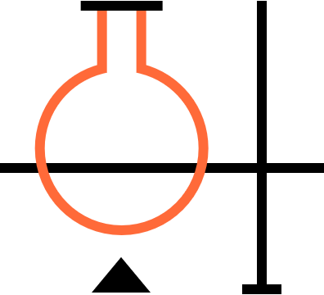
Proficiency Test Item vs. Reference Standards
Proficiency Test Item
Reference Standard
To implement quality control in
Analytical Processes
To evaluate
Laboratory Performance
Notes:
Comparison of Materials Items vs. Standards
Explaining how PT different form RS – + Recommend ---- RS are used in the testing process and PT items are not.
RS are used determine quality parameters of a sample PT items are uses to determine the level of analyst and by adjacency laboratory operation performance.

Slide 6
International Organization of Standardization (ISO)
Administered through certifying bodies with
millions of members
ISO
Harmonization of international standards & procedures
Ensures results equivalent among international testing bodies
ISO 9001
General requirements for a quality management system
ISO 17034
General requirements for the competence of reference material producers
ISO 17043
Conformity Assessment
General requirements for Proficiency Testing
ISO 17025
General Requirements for the competence of testing and calibration laboratories
  Demonstrate scientific and technical competence
  Supply required information about CRM materials
Technically
Valid Results
Meets Customer
Needs
Technical
Competency
Meets Statues
& Requirements
  Technical Competency
  Technically Valid Results
Allows the transfer of results between laboratories, calibration & validation
Ensures technical competency of laboratories, analysts & methods

Slide 7


Metrological Standards
The ‘Known’ or Key to Unlock Analysis
Ultimate Known
Metrological Agency
Primary Standards
Reference Materials Providers
Spex, NSI
Secondary Standards
Working Standards
Compared to Secondary
In-house

Slide 8



What are Standards, RM, CRM or Certified Standards?
Standard or Reference Material
?
Certified
Standard or Reference Material
?
‘ISO’
Certified
Standard or Reference Material

Slide 9








Functioning of PT
Laboratories
Results

Slide 10

What is Proficiency Testing?
Proficiency Testing is the evaluation of participant performance (competency) against pre-established criteria* by means of interlaboratory comparisons using a specified test material and method (scheme or study)
A scheme or study is the combination of test item and method evaluated at a specified time.
(*defined in ISO/IEC 17043:2010 clause 3.7)
Notes:
§211.25 Personnel qualifications.
(a) Each person engaged in the manufacture, processing, packing, or holding of a drug product shall have education, training, and experience, or any combination thereof, to enable that person to perform the assigned functions. Training shall be in the particular operations that the employee performs and in current good manufacturing practice (including the current good manufacturing practice regulations in this chapter and written procedures required by these regulations) as they relate to the employee's functions. Training in current good manufacturing practice shall be conducted by qualified individuals on a continuing basis and with sufficient frequency to assure that employees remain familiar with CGMP requirements applicable to them.
(b) Each person responsible for supervising the manufacture, processing, packing, or holding of a drug product shall have the education, training, and experience, or any combination thereof, to perform assigned functions in such a manner as to provide assurance that the drug product has the safety, identity, strength, quality, and purity that it purports or is represented to possess.
(c) There shall be an adequate number of qualified personnel to perform and supervise the manufacture, processing, packing, or holding of each drug product
3.1: What is the intent of the statement in ICH Q7, paragraph 3.12 “training should be periodically assessed”? In ICH Q7, paragraph 3.12, the statement “training should be periodically assessed” refers to a system to evaluate if personnel remain proficient and competent in their job tasks and responsibilities, whether more frequent, additional, or new training is needed, and if recurring training is up to date.

Slide 11


What is Proficiency Testing?
A measure of the performance (ability):
  of two or more participants
  to provide accurate and precise
  [Results]
  on the same or similar
  [Test Material]
  in accordance with pre-determined
  [Analytical Method]
Scheme
Notes:
Measurements of Proficiency and analyst competency

Slide 12








Laboratory Benefits of PT
Demonstrate competency to 3rd parties and regulatory bodies
Fulfill Accreditation requirements
Manage risk through early warning of problems
Compare results with laboratories around the world
Independent Evaluation
Ensure customer confidence in laboratory results
Educate and train staff
Identify problems and areas of improvement
Notes:
Why laboratories should perform PT

Slide 13
Material Selection Criteria
KEY
Methodology identifying during study development which is based on compendial or internationally recognized validated methods.
Homogeneity
Homogeneity
Suitability
Stability
Stability
Physical Properties
Robust materials that are suitable, having identifiable chemical structure, genus or species, and safe are provided to the participants within schemes which meet the requirements for being "Fit for Use or Purpose".
Physical Properties
Methodology
Morphology
Organism
Organism
Non-Toxic
For safety purposes, The PT Program provides participants with materials that are stable with minimal volatility and toxicity to prevent mishandling.
Hazardous
Non-Lethal
Notes:
Describes the process for material selection for schemes. Answers the question how the program selected material and schemes.
Which analytical test does the analyst need to proficiency?
What material or analyte is suitable,

Slide 14



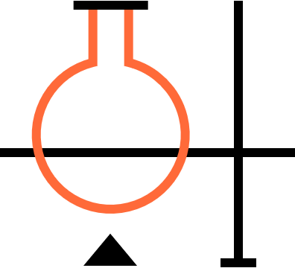


Proficiency Testing Laboratory Market
OMCLs
GMP Manufacturers Internal Laboratories
Clinical Research
Organizations
Commercial Labs
Food and Cosmetic Organizations
Contract Drug
Mfg Organizations
(Official Medicines Control Laboratories) government laboratories that provide medicines testing for the purchase, approval, registration, PMS studies, and regulatory enforcement support within developing countries.
OMCLs include both pharmaceutical and clinical testing laboratories.
Primary manufacturers of API and FP in addition to products in other areas.
The GMP manufacturers have internal testing laboratories to ensure the manufacturing process, quality and safety is confirmed.
Supports the testing of medicines delivery in human and non-human samples within clinical, hospitals, and private medical facilities.
The CROs have internal testing laboratories to ensure the product identification and delivery results are confirmed.
Serves as 3rd party contracting testing laboratory.
Support the food and cosmetics microbiology testing of non-human samples within food and cosmetic facilities.
Serves as 3rd party manufacturer facilities that support API and FP production in multiple areas such as pharmaceutical / biopharmaceutical, microbiology, food and beverage , etc.
The CMO’s have internal testing laboratories to ensure the manufacturing process is verified.
Notes:
Who are the focus? Laboratories that are required to PT on the methodologies of the schemes. Have internal training programs that use PT but are not accredited or who have had documented issues related to training and method implementation.
All laboratories are testing laboratories -Serves testing facilities that support sample testing in multiple areas such as pharmaceutical / biopharmaceutical, microbiology, food and beverage , cosmetics, forensic, environmental, animal feed, Schedule 1 products, veterinary, etc.

Slide 15




USP PT Program Customer Benefits
In-house manufacturing by established provider
Leverages trusted USP methods*
Underpinned by best-in-class scientific expertise
Expert and highly responsive technical support
*USP methods are often referenced by several PT competitors
Notes:
Four main points of why customers should purchase PT.
Immediate accessibility to customer Support
Manufactured by people who understand
Designed based on technical design of bulk materials
Trusted Guidance for Product selection
Not a chemical provider, an accredited PT provider
customer benefit Specific to USP
Studies use General Chapters and Monographs as direct source
USP experiences with RS is used to determine study selection
USP has been an independent third party for 200 years
USP is a documentary standards producer that supports testing labs
Competitors are currently using USP to reference the selling of their product
USP value diagram and indicate linkages to. How the PT program links to the other products and services

Slide 16
PT Correlation w/ General Chapters
Analyst Performance
Analytical Method
Analytical
Instruments
PRODUCT
TESTS IN MONOGRAPH
GENERAL CHAPTERS
TECHNIQUE
INSTRUMENTATION
Acetaminophen tablets
Identification
Assay
Performance test
Impurities
<621>
<857>
<711>
<905>
pH
LOD
HPLC
UV
Dissolution
Karl Fischer
PT SCHEME
Acetaminophen capsules
Analytical QC Processes
Reference Standard
Internal Control
Instrument Calibration
K2M244
Notes:
Purpose: to instruct SCD on which PT schemes they can promote/suggest to the customer based on their current purchasing history with USP, by illustrating how schemes are connected to general chapters and by default reference standards. Answering the question, which schemes should be promoted to a customer? How does SCD know if a custom needs a specific scheme?
To illustrate the relationship, we use K2M244, Acetaminophen a commonly purchased reference standard. {shown in the bottom row of slide) If a customer purchases K2M244, we can safely assume they are testing an API or finish product that contains acetaminophen such as acetaminophen tablets or capsules. (Shown under product). In testing these products in accordance with the monograph, they would need to obtain results for identification, Assay, etc. (listed under Test in Monograph), the general chapters associated with these tests are listed under (technique Instrumentation). From there you can recommend which scheme is needed. Additionally, a laboratory may be accredited for the complimentary techniques required for another, say for instance HPLC. In order to perform a HPLC assay, the customer has to be competent in the performance of pH determination for mobile phase preparation, LOD for drying of standards, and determination of water concentration by Karl Fisher for back calculation. All schemes available within the PT program list of schemes. AGREE
Top row summary: analyst must prove that they are competent to perform testing. This competency includes an understanding of the analytical method and usage of the instrumentation to obtain accurate and reliable results.
Middle section: further details and gives examples for elements needed to obtain accurate and reliable results using standard methodology, with USP as the reference method.
Bottom row summary: example of reference standard and its usages

Slide 17
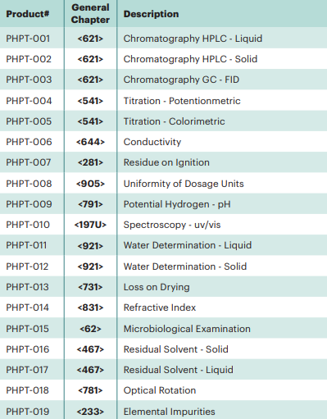
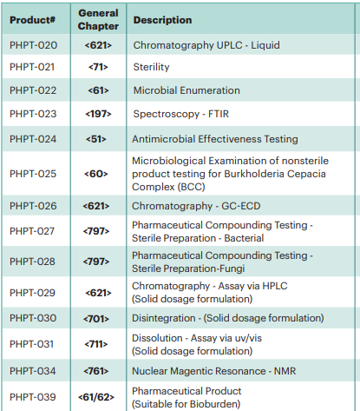
USP PT Schemes
Over 70 Schemes based on USP Chapters

Slide 18



Direct Ordering- Process Overview
1
Order Scheme
2
Physical Sample
3
Electronic data (results)
Customer
4
Report
Notes:
This slide represents an overview of the PT process from the customer’s point of view.
The customer orders Proficiency Testing Schemes(studies) online from NSI website.
the program (NSI) ships items to customer along with associated documentation
Customer tests (analyzes) material and enters results into the USP PT Portal using predefined format
NSI analyzes results and provides customer with report

Slide 19



Ready to Start?
Plan
Fit for Purpose
Policies
Prepare
Maintenance
Delivery Schedule
Execute
Calibrations
Checks & Calculations

Slide 20
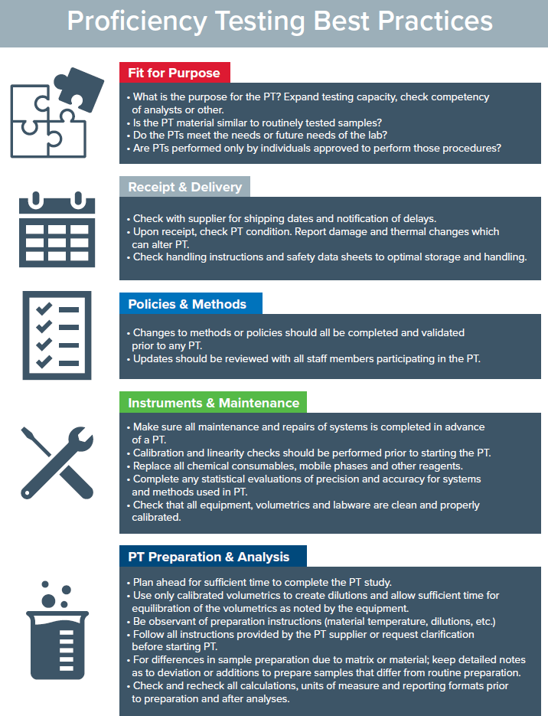
Plan

Slide 21
Prepare

Slide 22
Execute

Slide 23
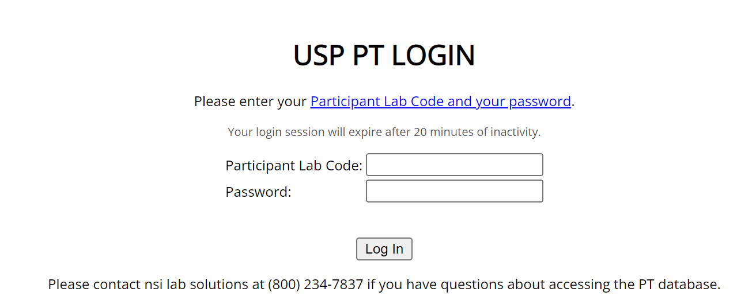


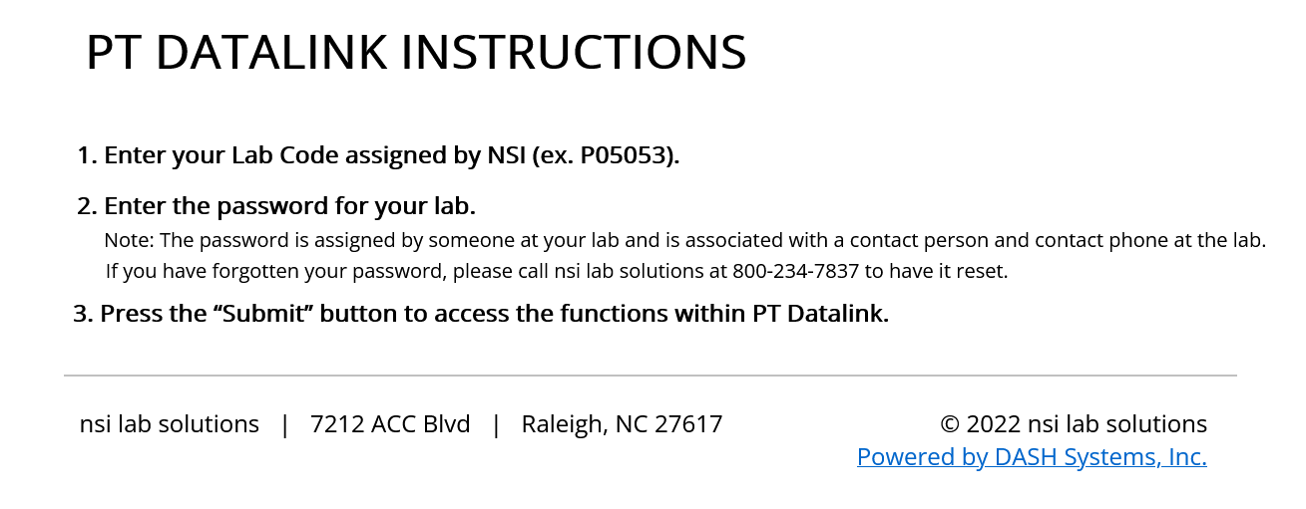
PT Portal
https://pharmapt.nsilabsolutions.com/dlSelectStudyView.do
Notes:
Login after payment is made
https://pharmapt.nsilabsolutions.com/dlSelectStudyView.do

Slide 24
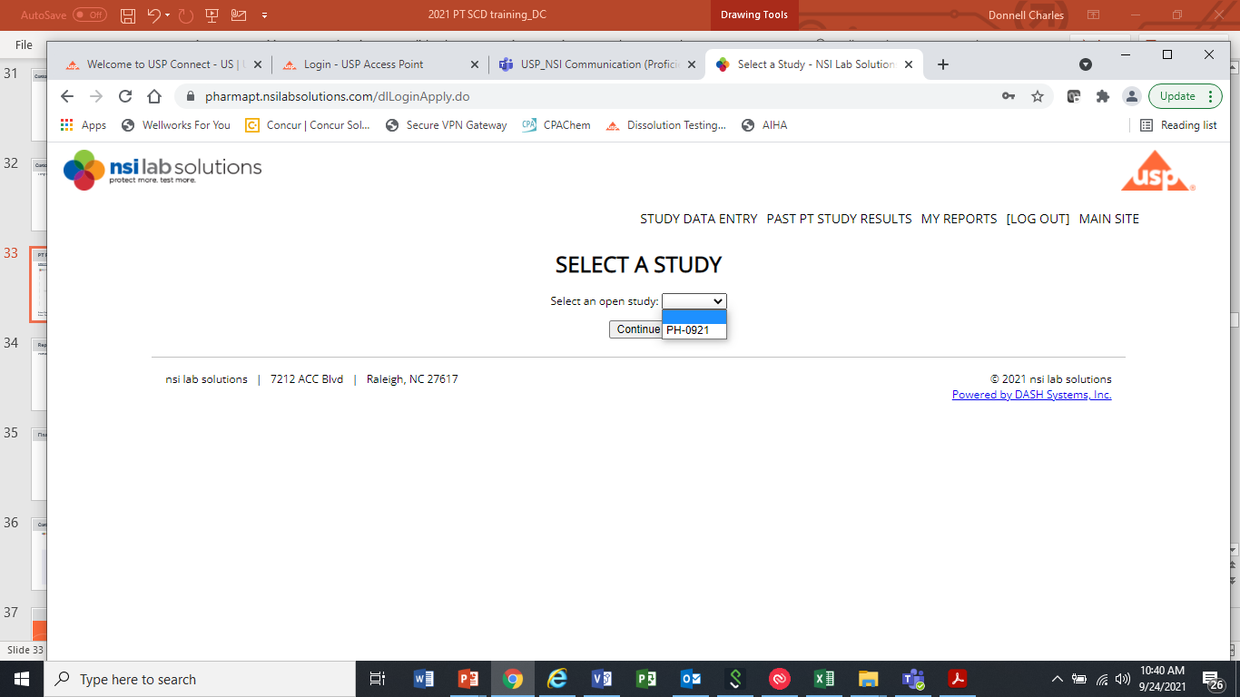
PT Portal
https://pharmapt.nsilabsolutions.com/dlSelectStudyView.do
Notes:
Login after payment is made
https://pharmapt.nsilabsolutions.com/dlSelectStudyView.do

Slide 25
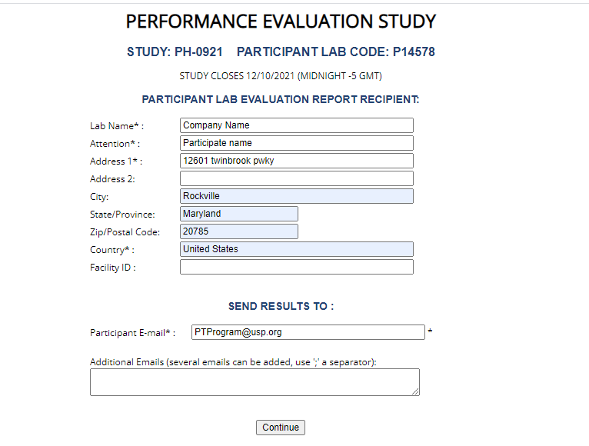
Performance Evaluation Reporting
Enter-Participant Information
Select- Continue
Select- Locate Study

Slide 26
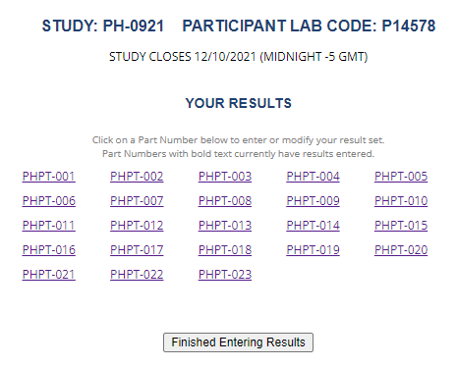
Performance Evaluation Reporting

Slide 27
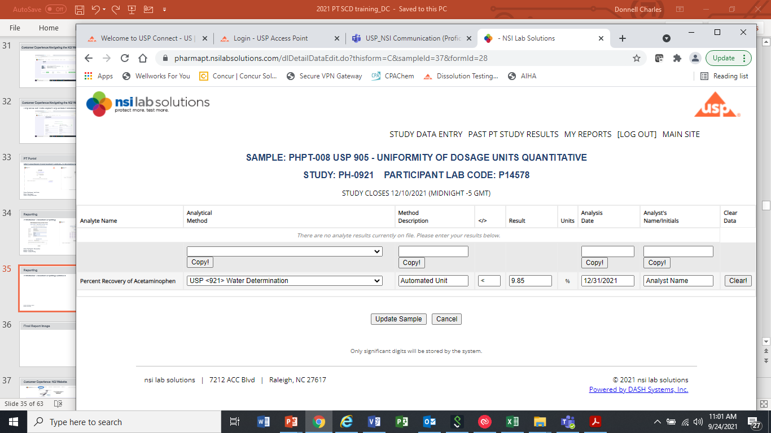
Performance Evaluation Reporting
Select- Enter Required Information
Select- Update Sample for Submission
Select- Finished Entering Result ( Repeat Process for each study)
Receive- Submission notification via email
Completion- LOG-OUT

Slide 28
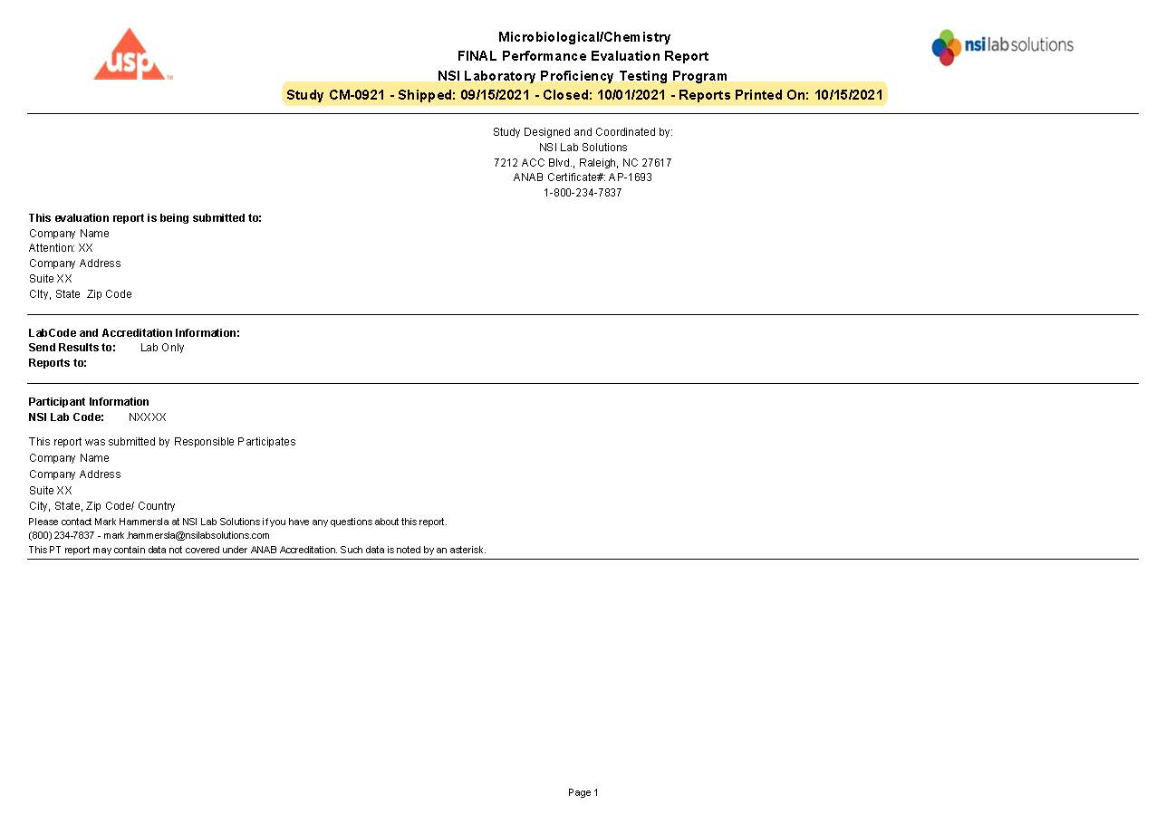
Sample Results Report
Notes:
Displays- Report information, Round, closing dates, Report printing

Slide 29
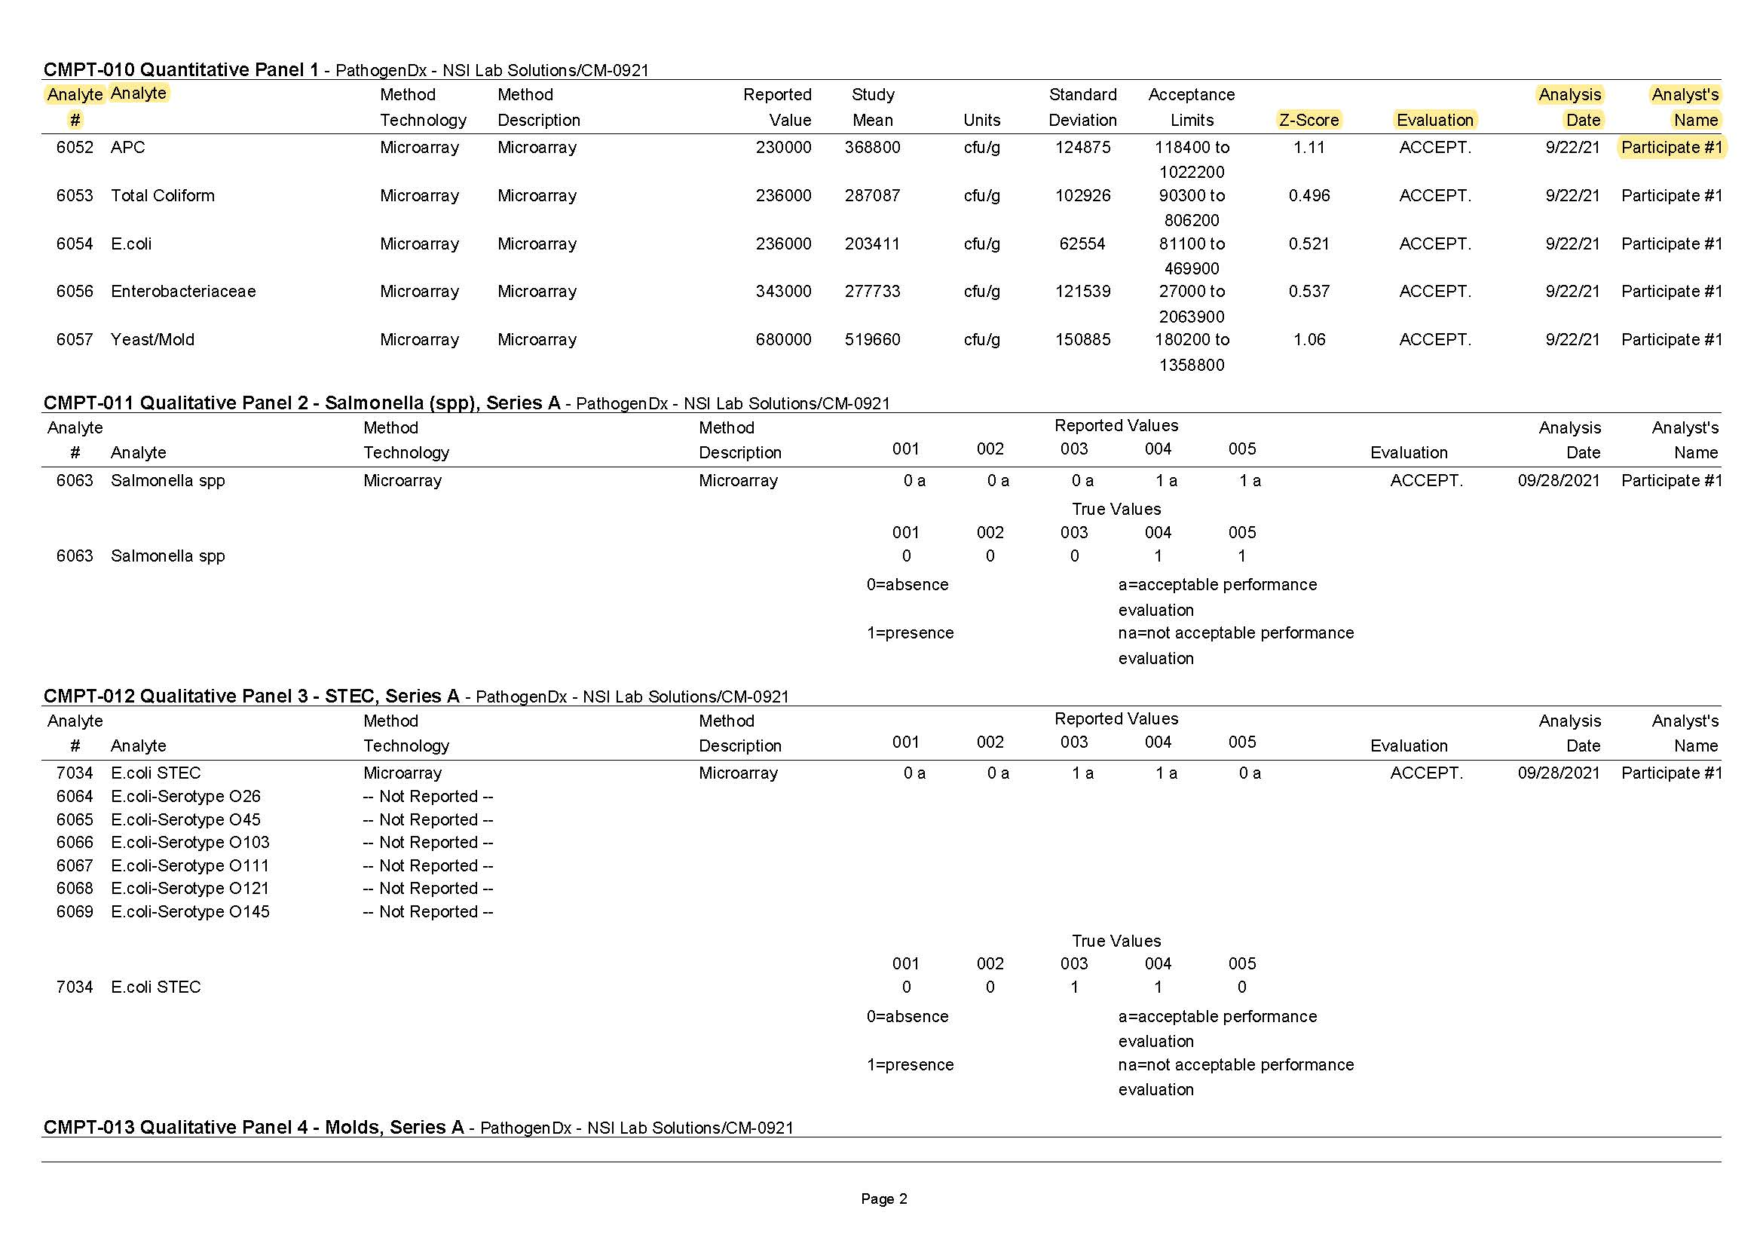
Sample Results Report- Continued
Notes:
Displays: Analyte, Method, Z-score, P/F and Participants name
Quantitative Report

Slide 30








Non-conforming Results?
Sample storage and handling
Sample = PT
Prep?
Process changes?
Calibration, Dilutions
Dynamic Range
Standards & Controls
Calculations & Units

Slide 31
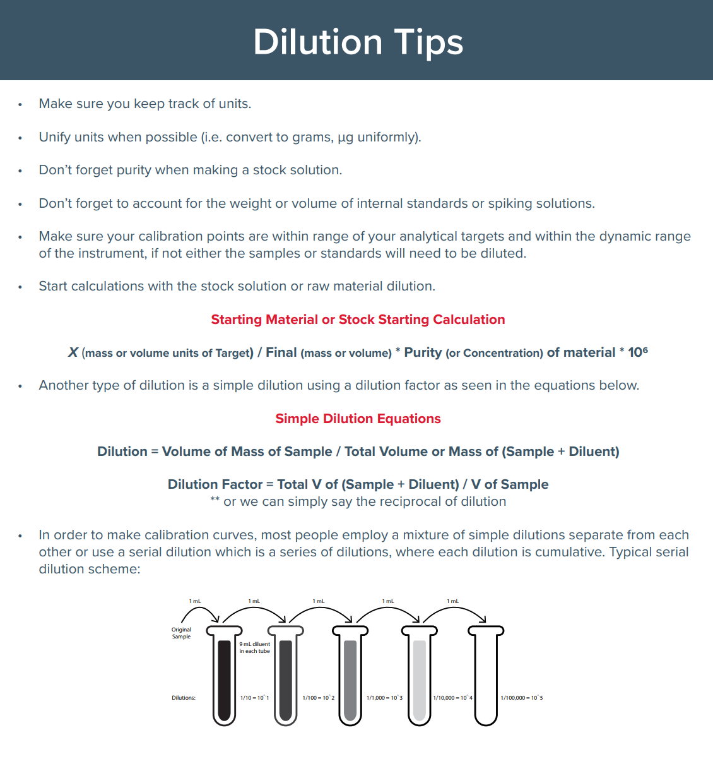
Dilutions

Slide 32
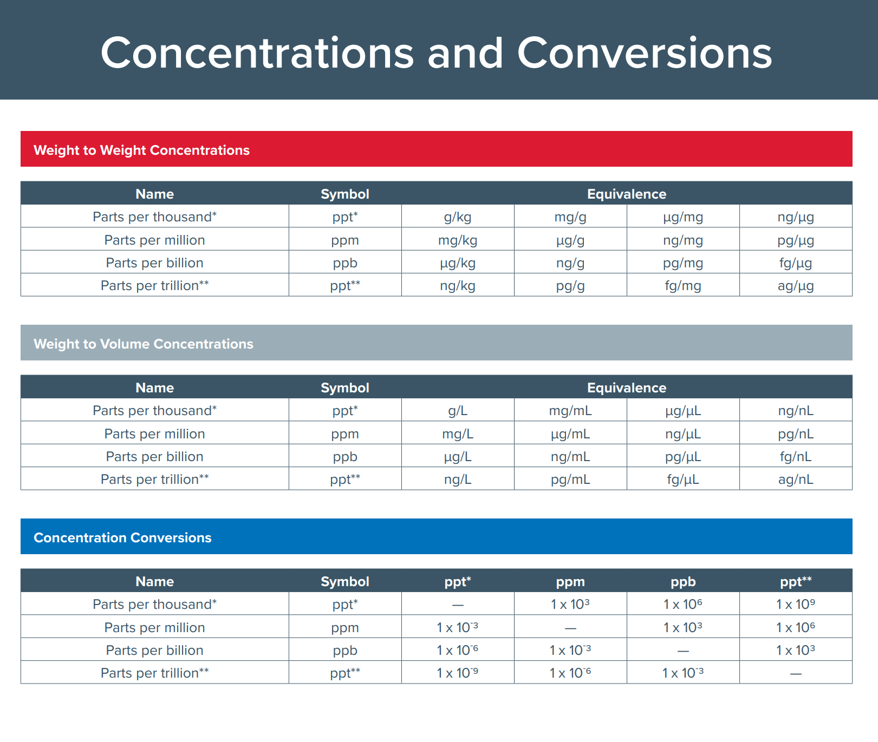
Concentration, Conversions & Units

Slide 33
Infographics

Slide 34



White Papers & Publications: In Print Soon

Slide 35
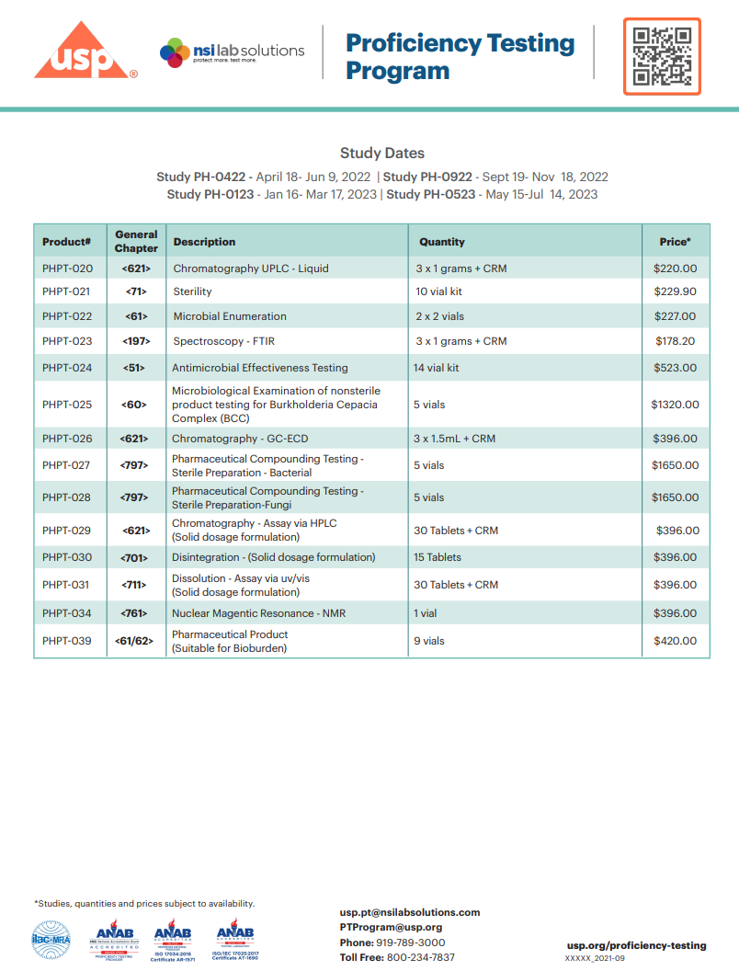
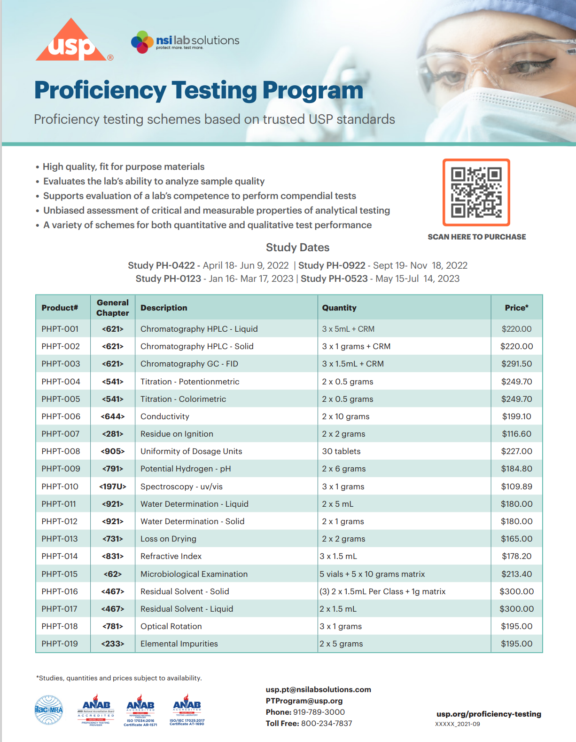
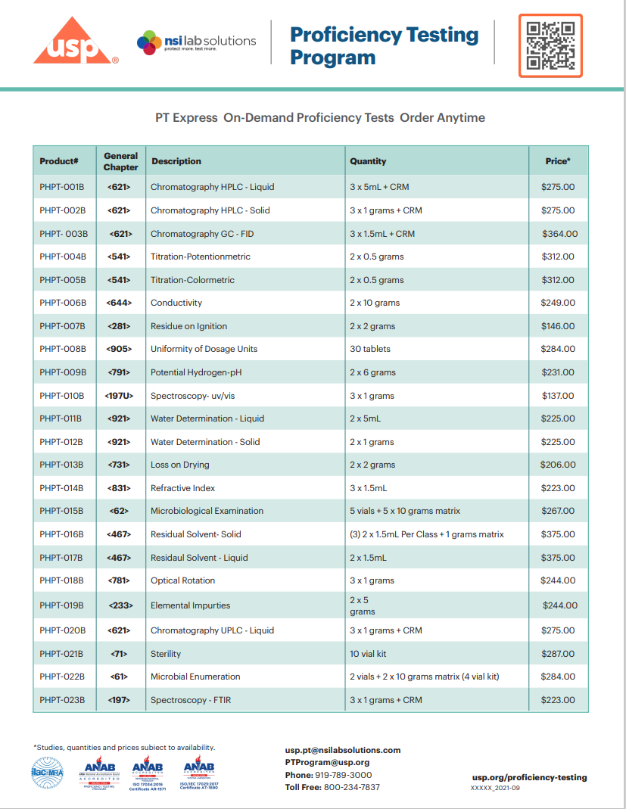
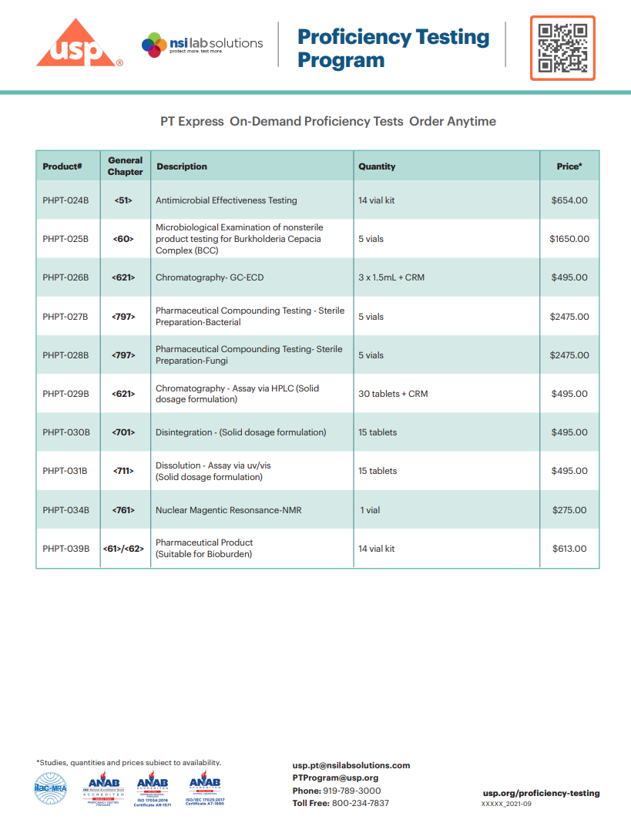
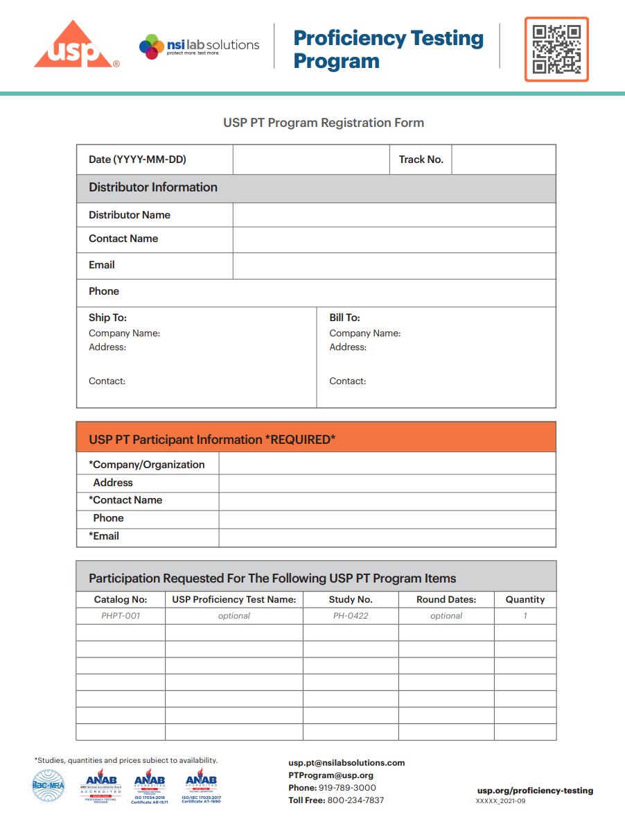
PT Testing Program

Slide 36

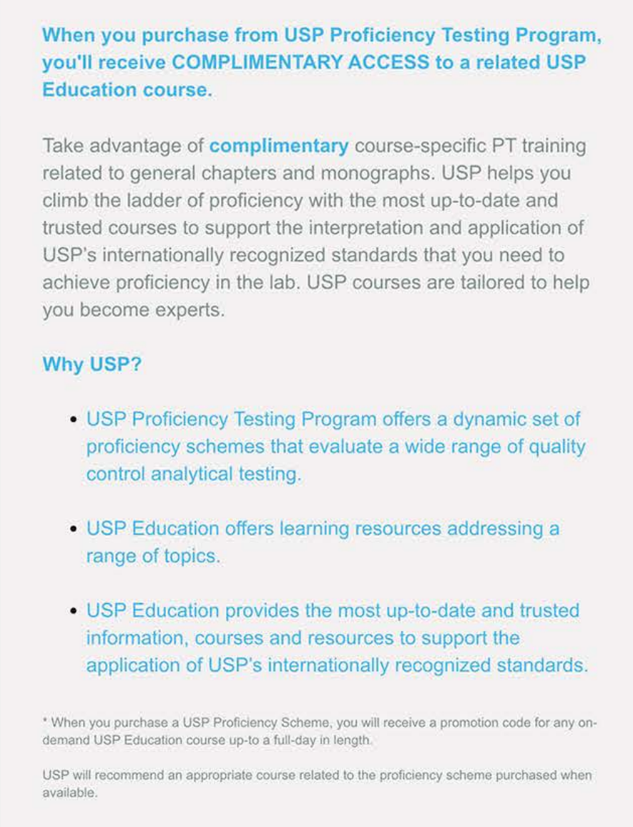

Education

Slide 37


Links for More Information
https://www.usp.org/proficiency-testing/external-faqs
FAQ
Study Portal
www.spex.com
Help with Standards

Slide 38
Thank You
Questions?

